Slide 1
PEOPLE’S COMMITTEE OF DISTRICT 3 DEPARTMENT OF EDUCATION AND TRAINING

Slide 2
PEOPLE’S COMMITTEE OF DISTRICT 3 NGUYỄN THI PRIMARY SCHOOL
SUBJECT: ENGLISH
Teacher: Võ Thị Mỹ Phượng
District 3, October 6th , 2021.

Slide 3
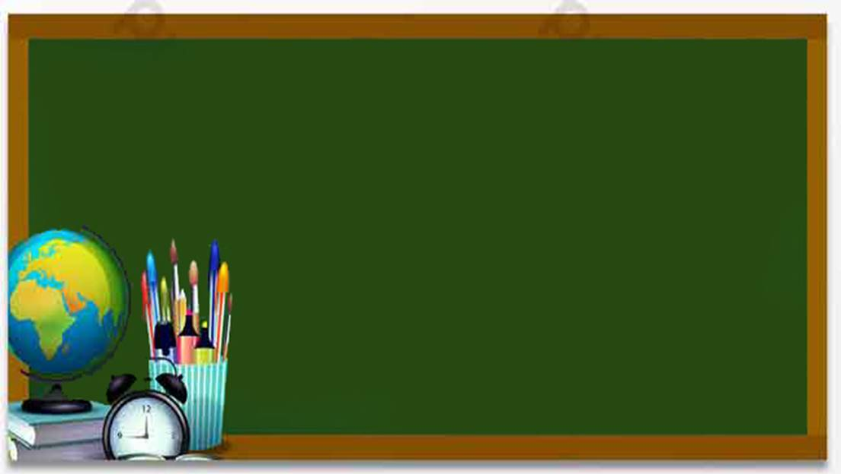
Starter : Hello!
Lesson: 6

Slide 5
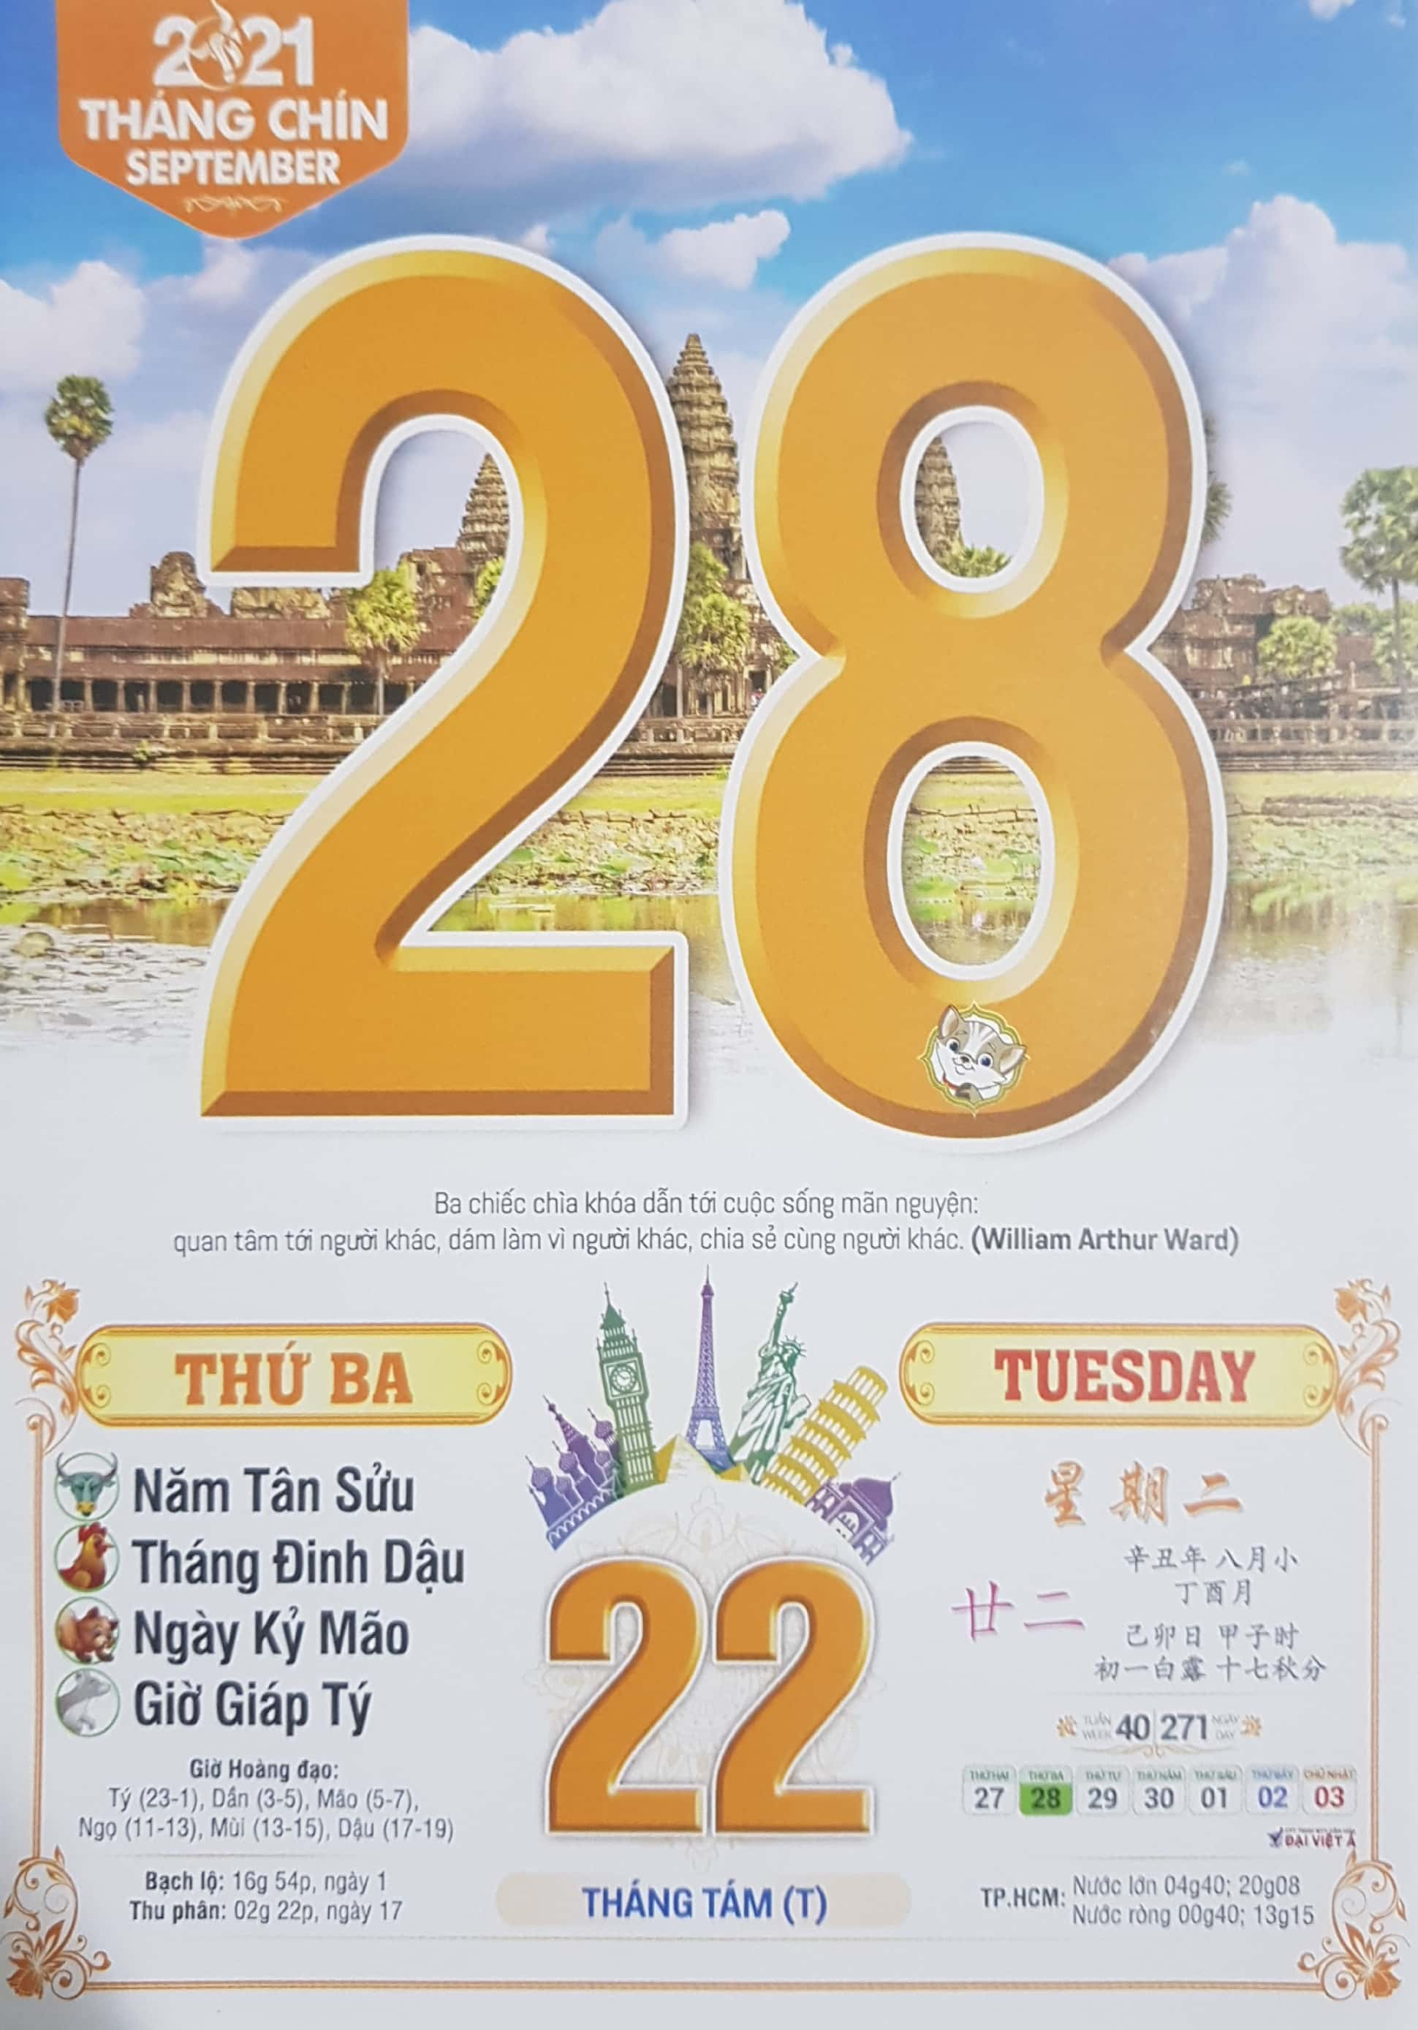
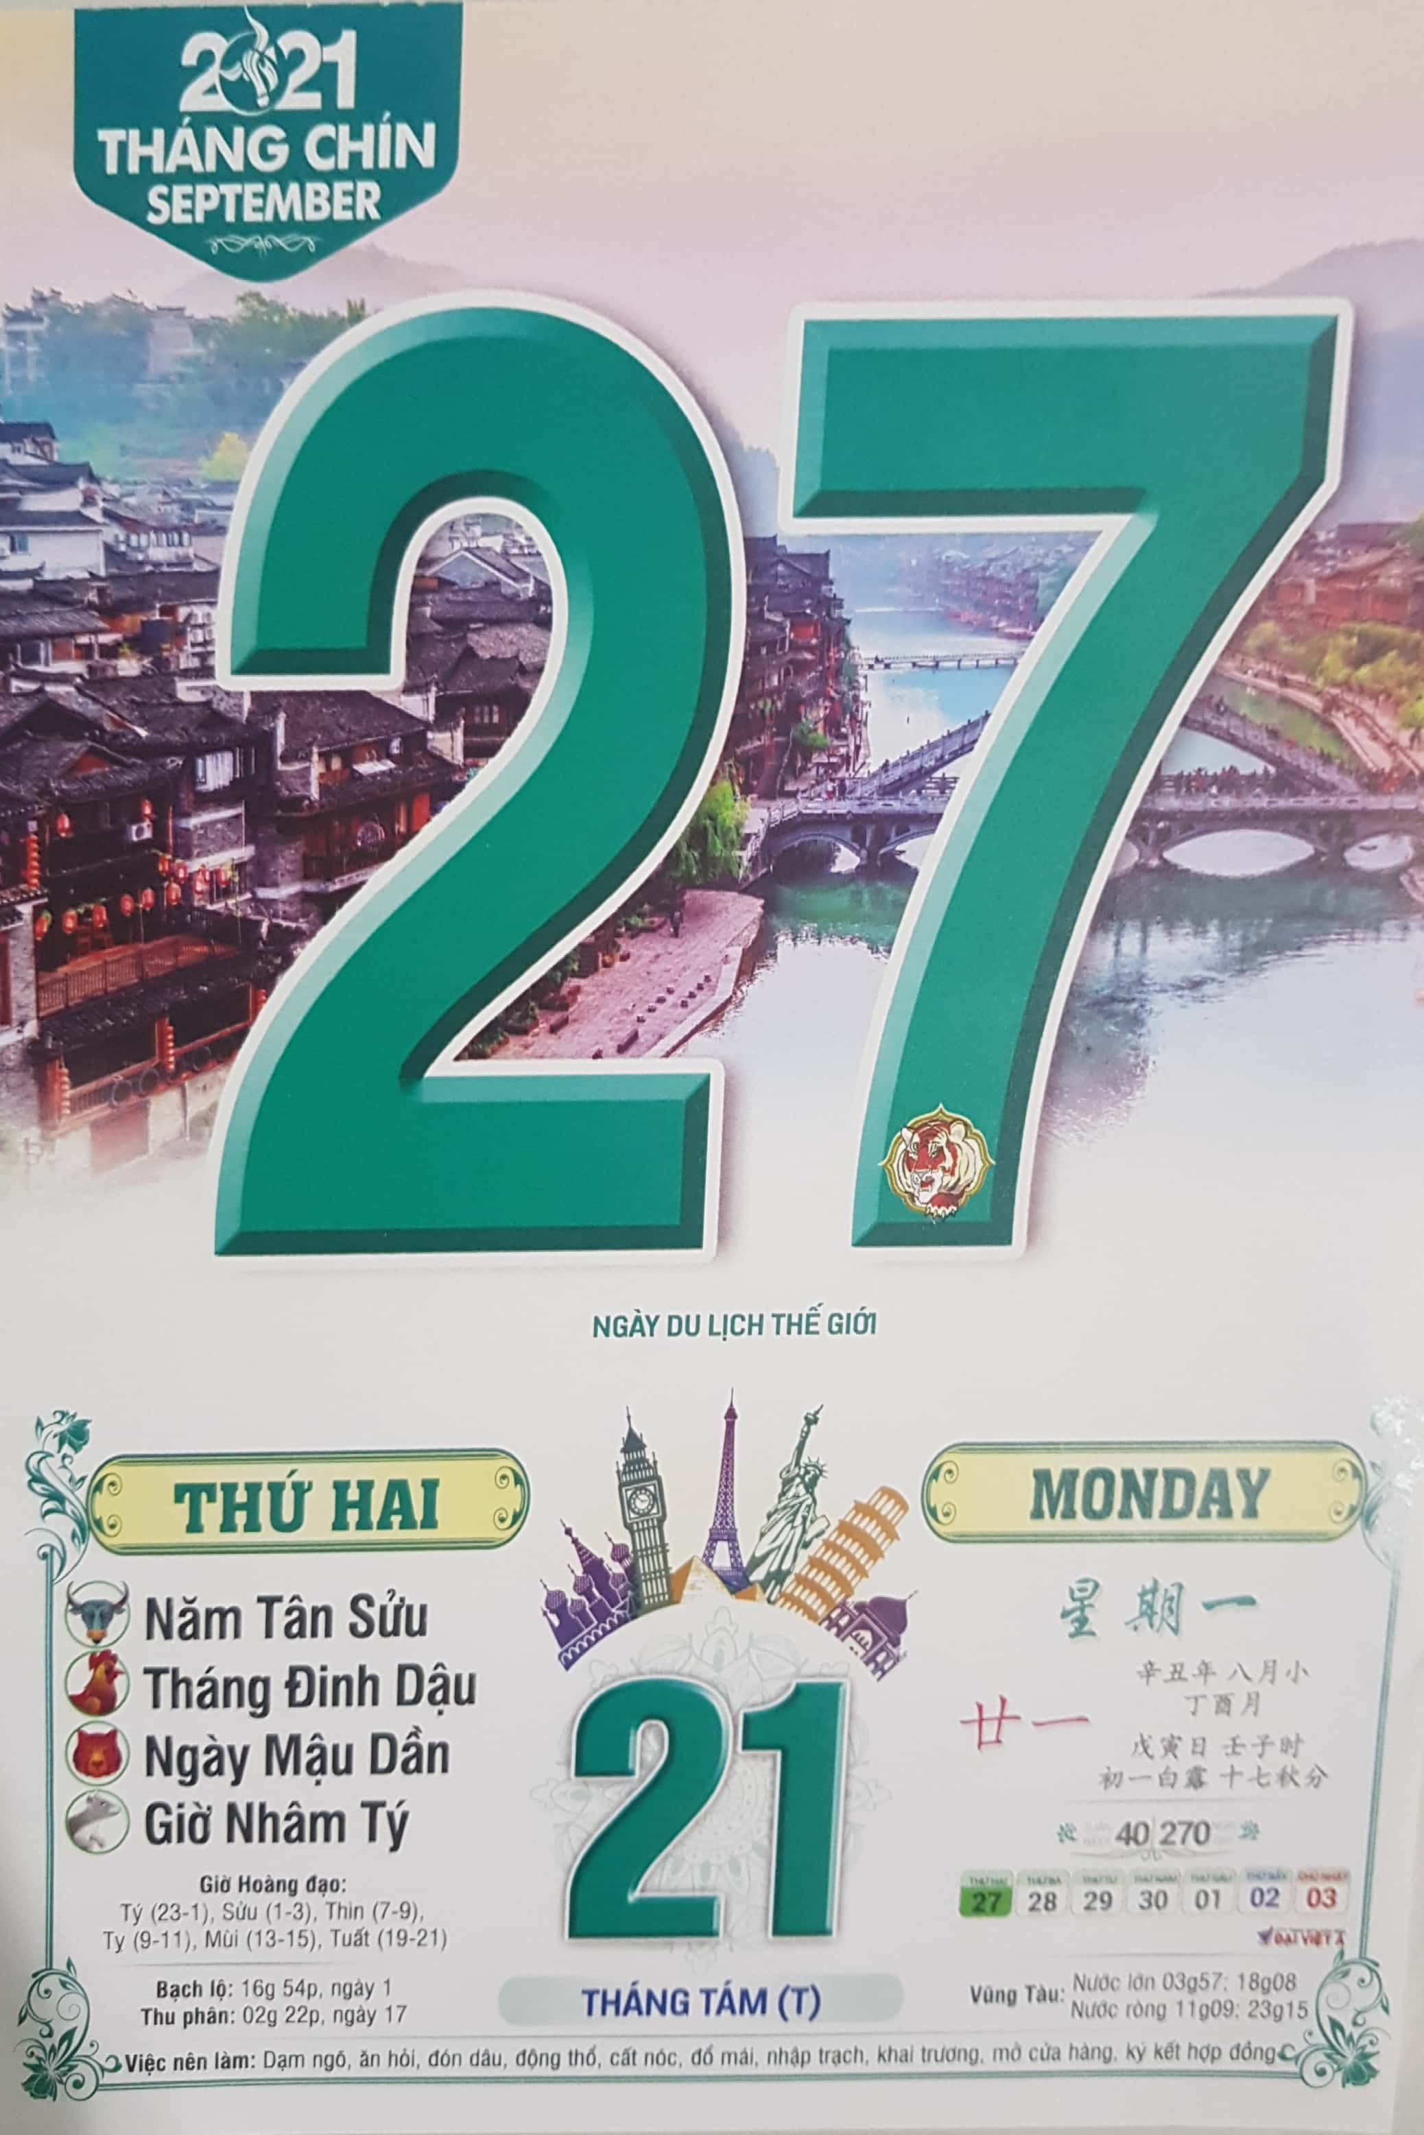
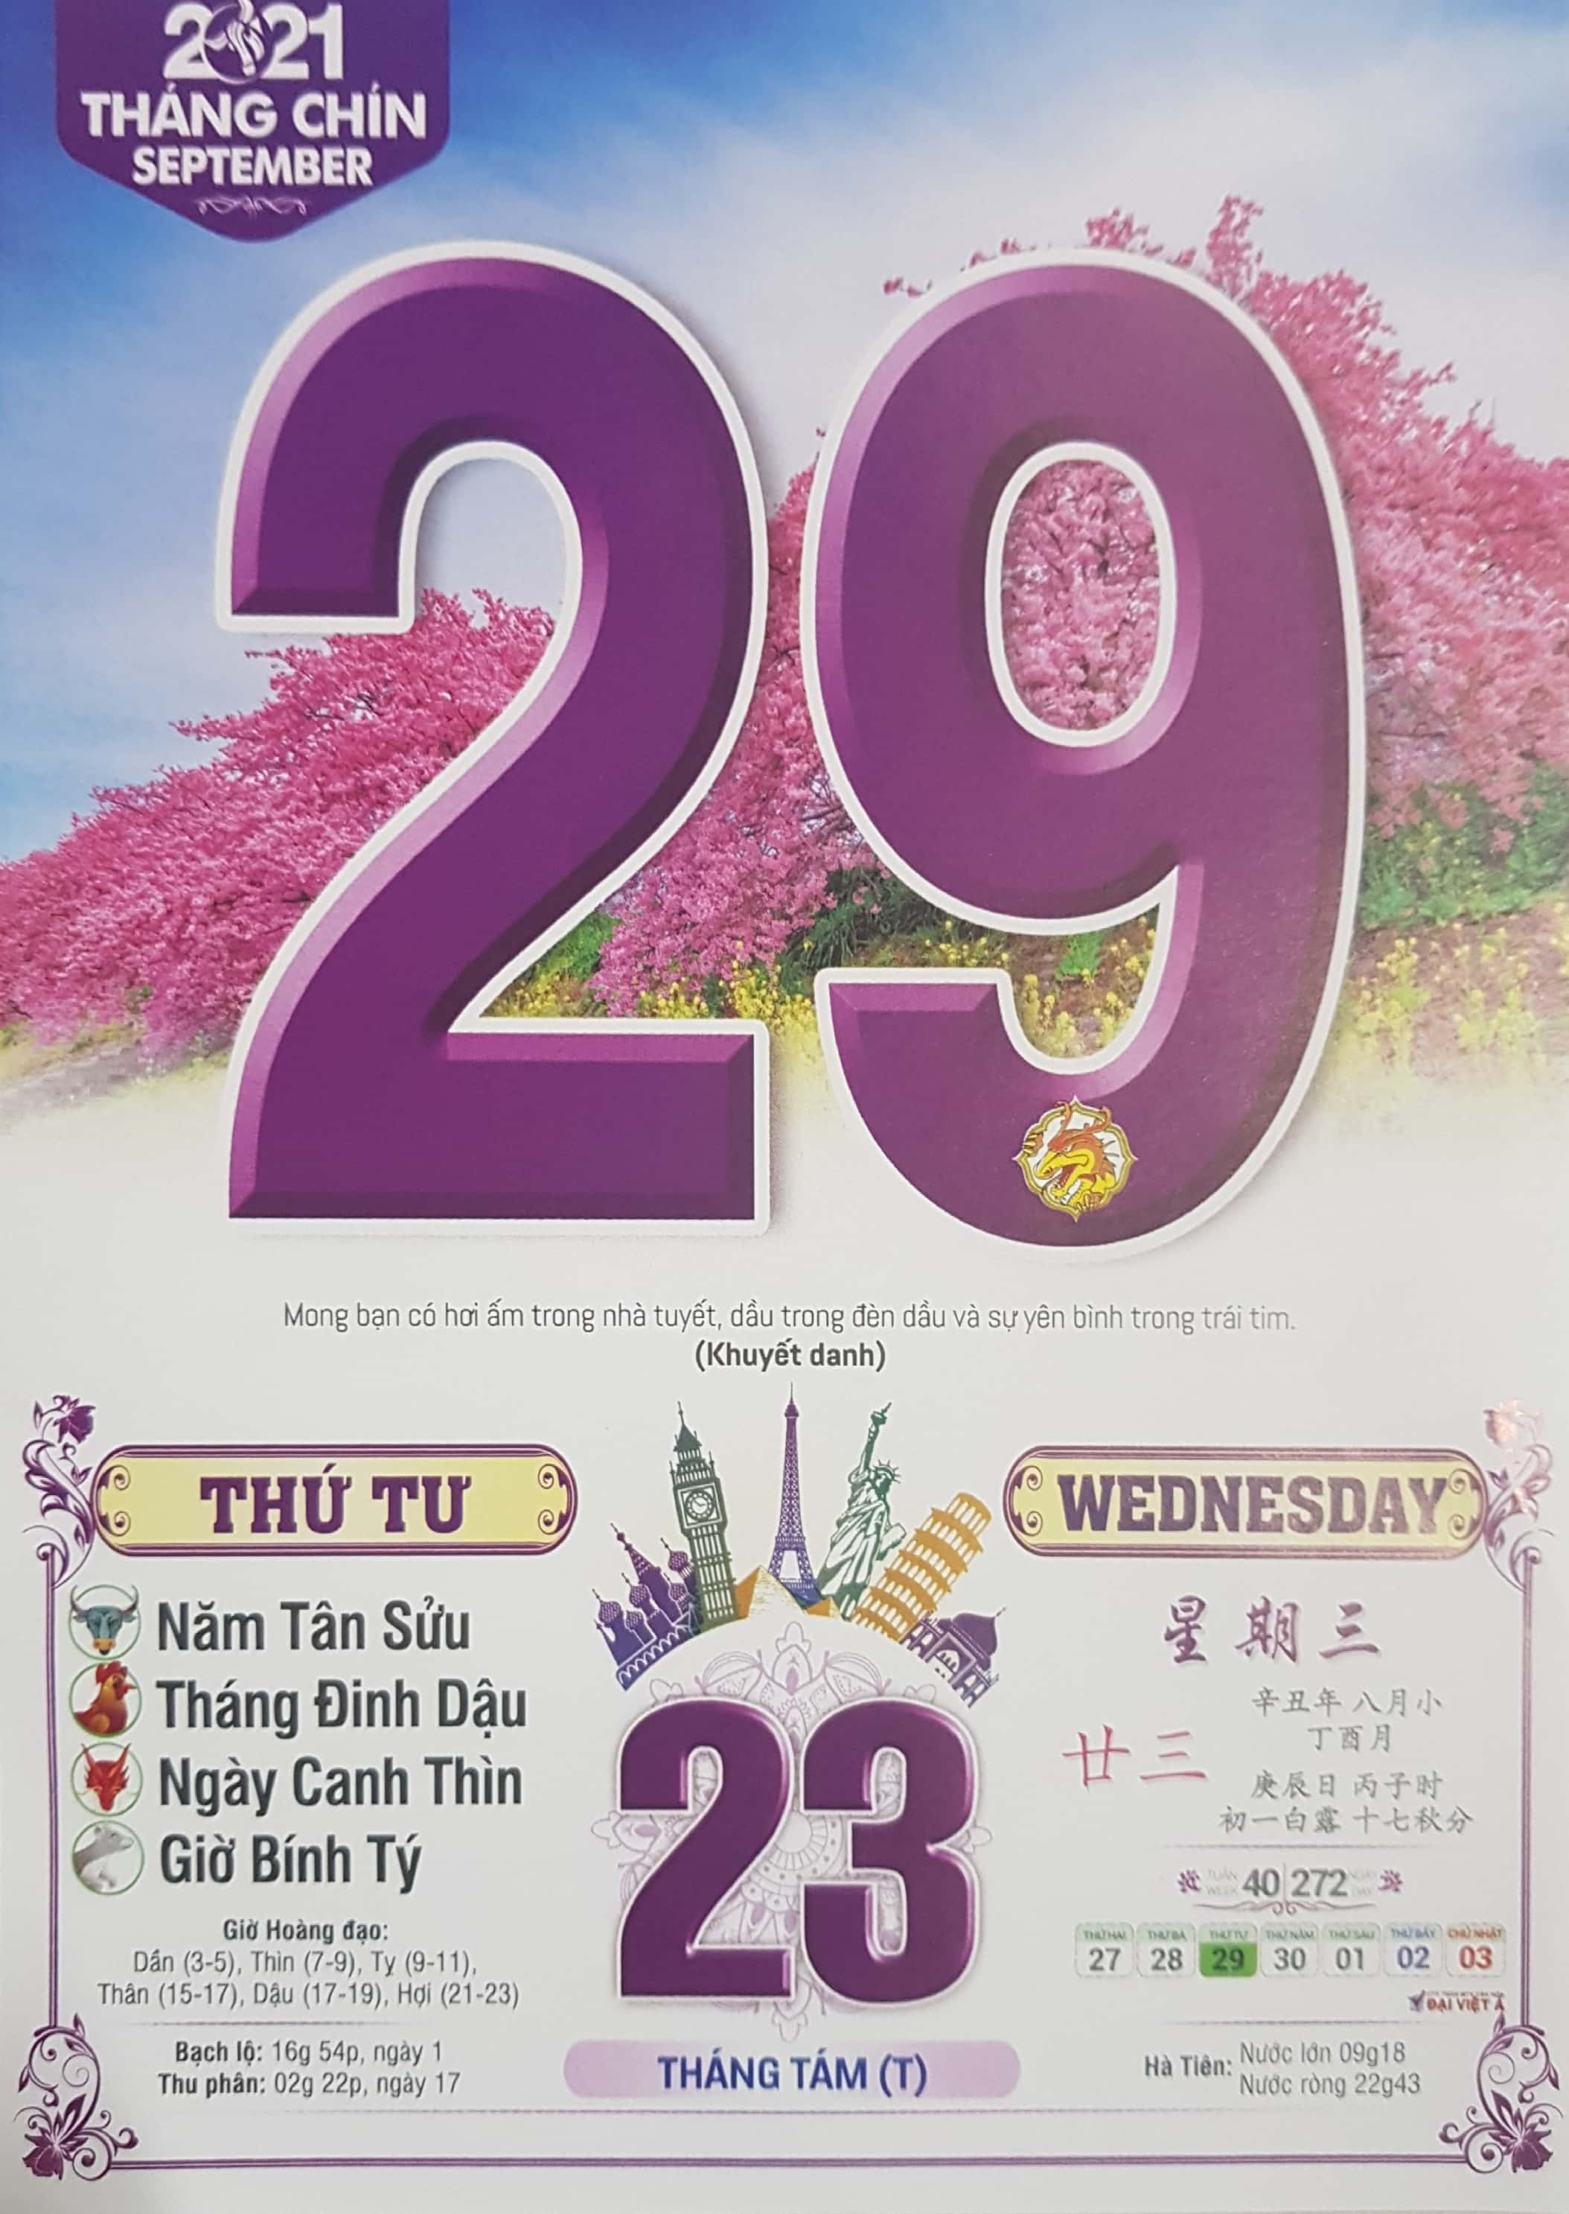
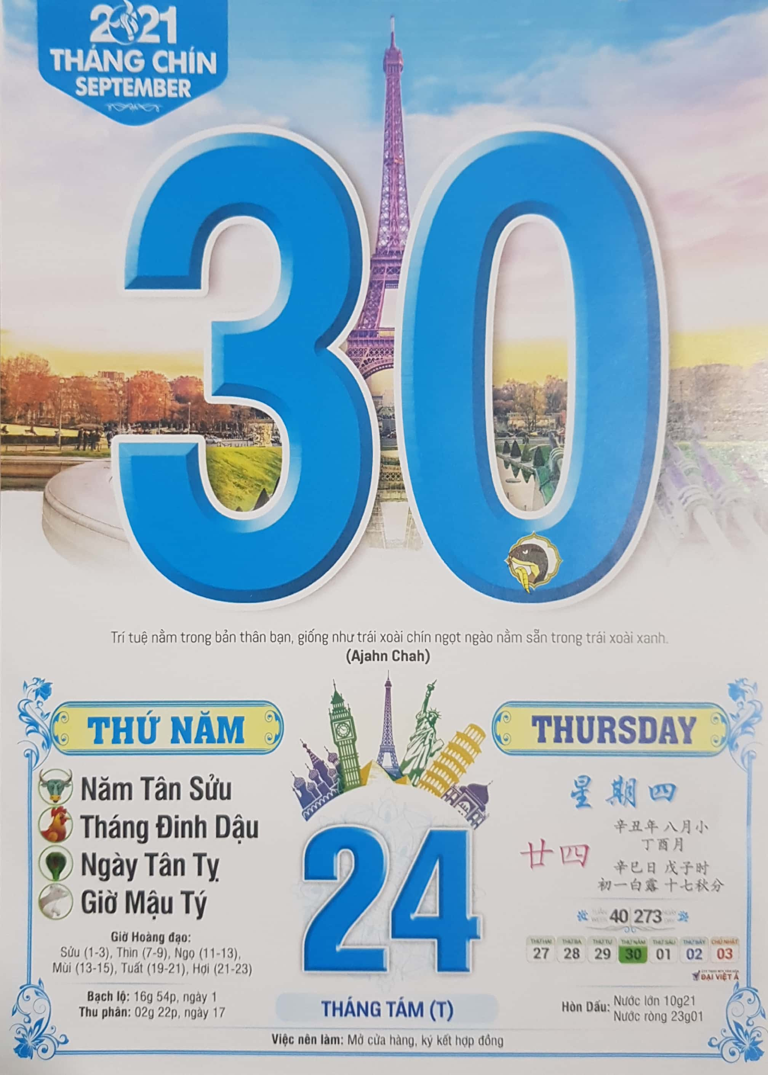
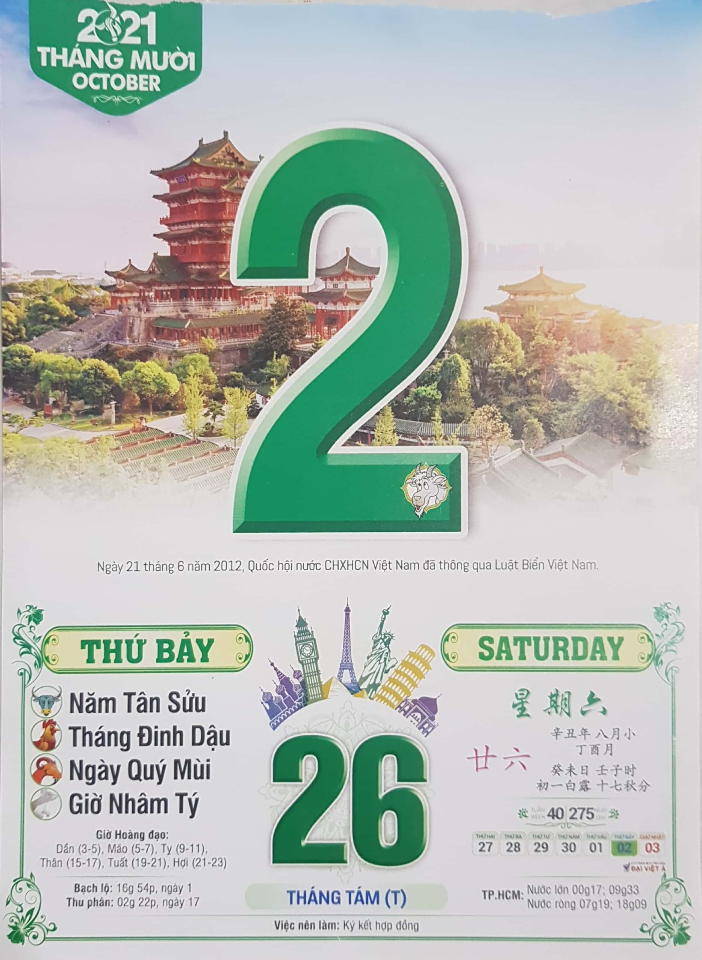
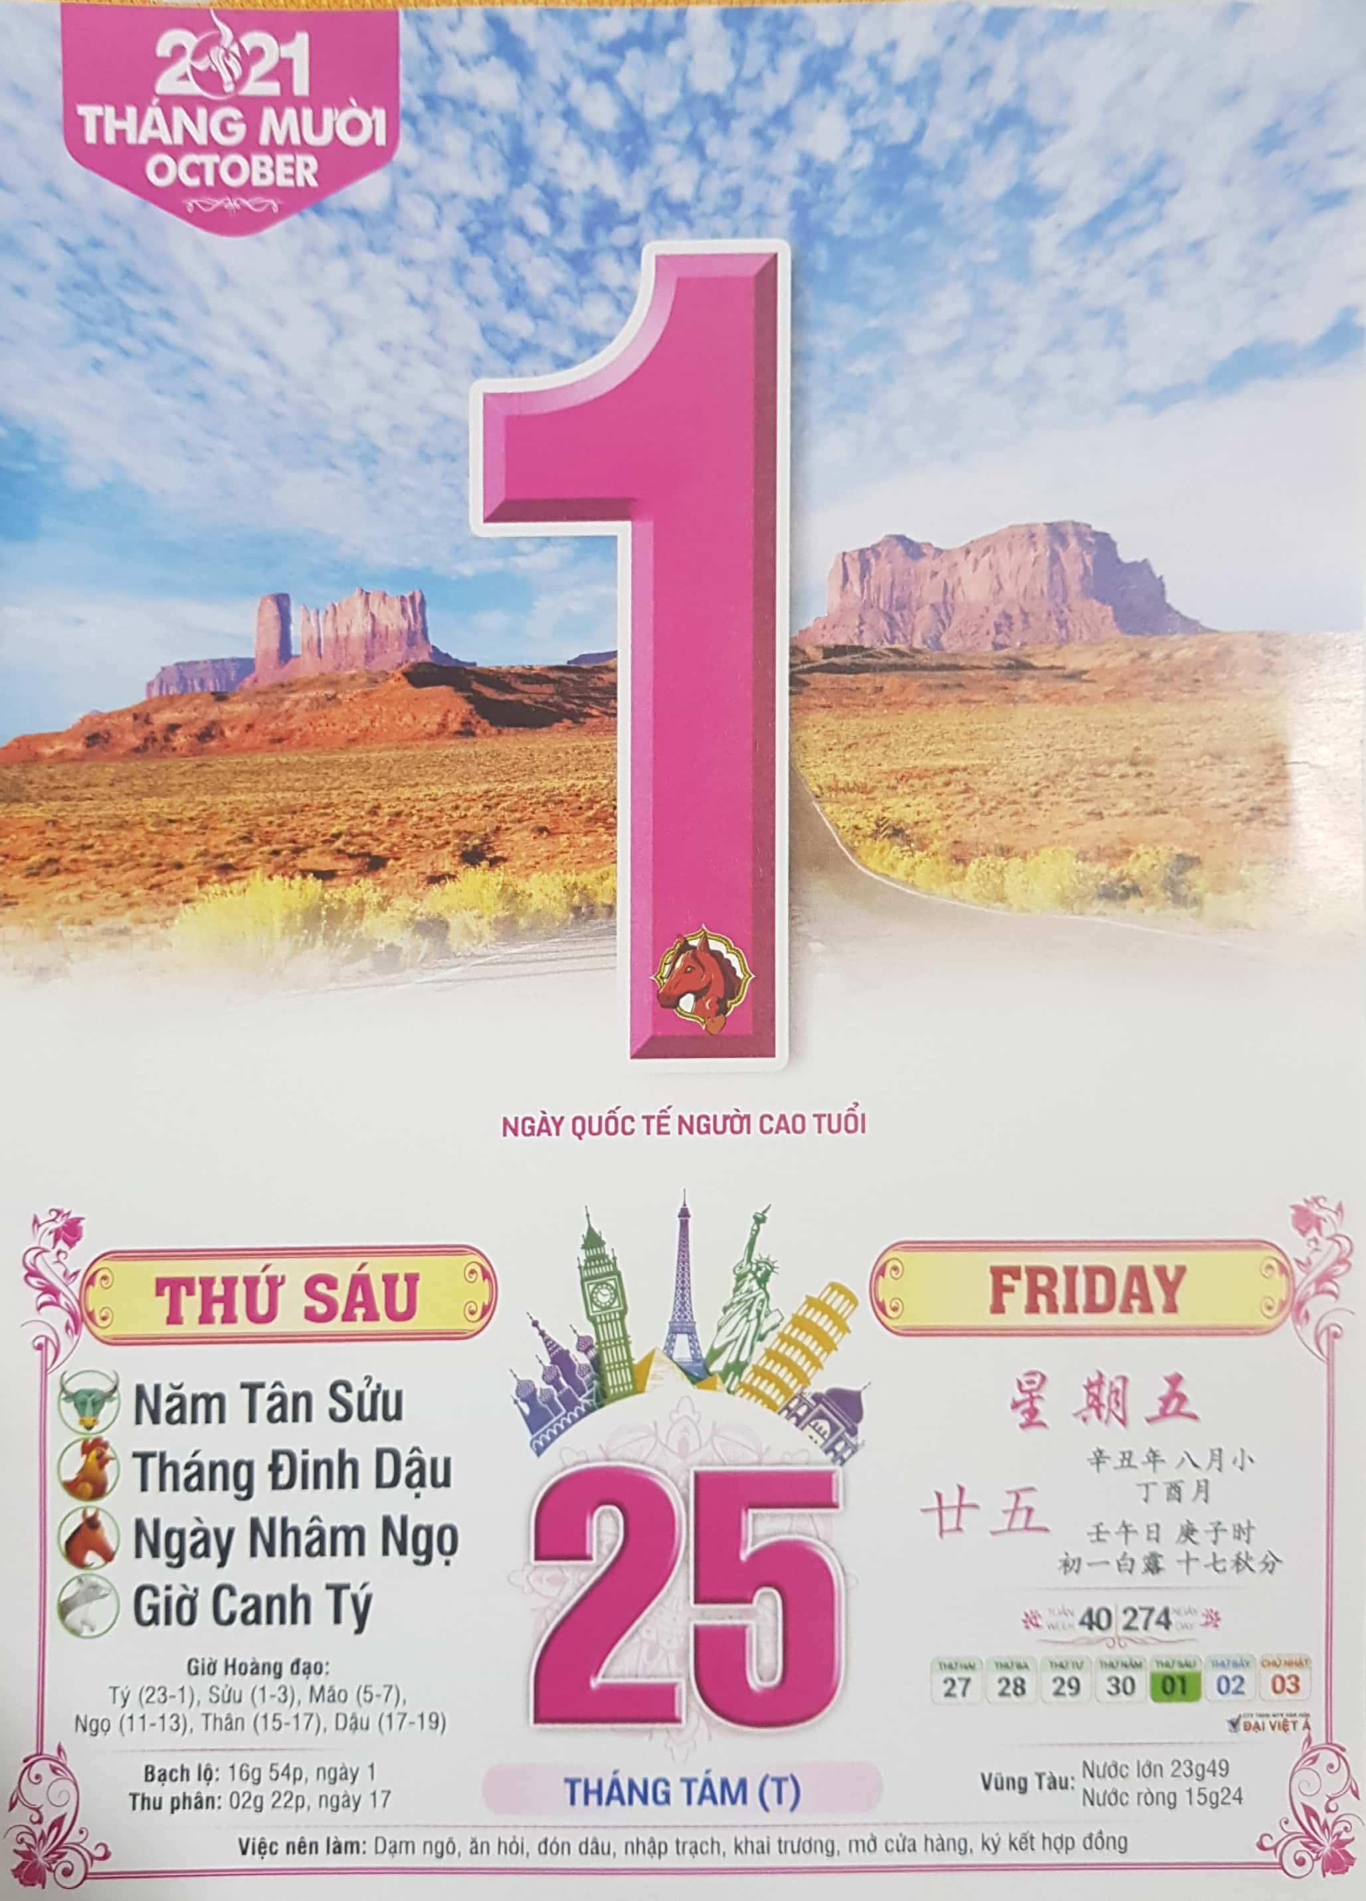
Monday
Tuesday
Wednesday
Thursday
Friday
Saturday
Sunday

Slide 6
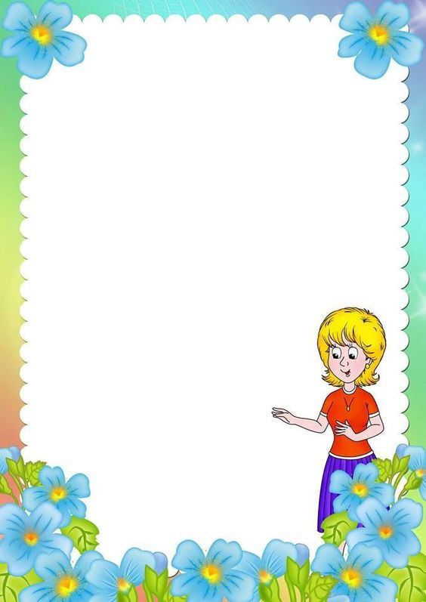
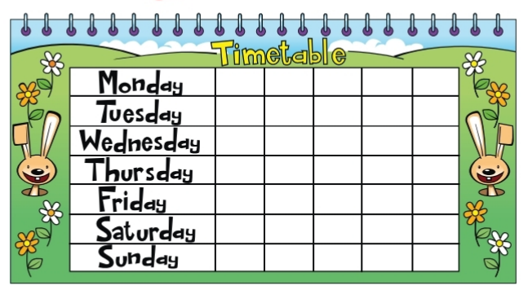
Days of the week.

Slide 7
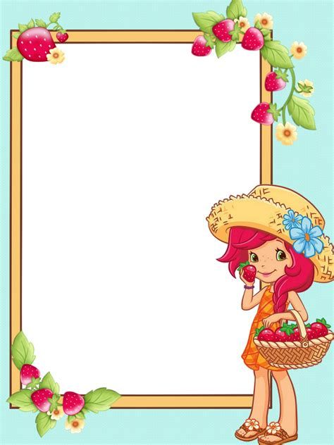

Slide 8
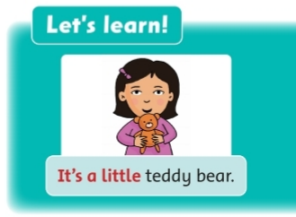
big
little

Slide 9
It’s a…. chair.

Slide 10
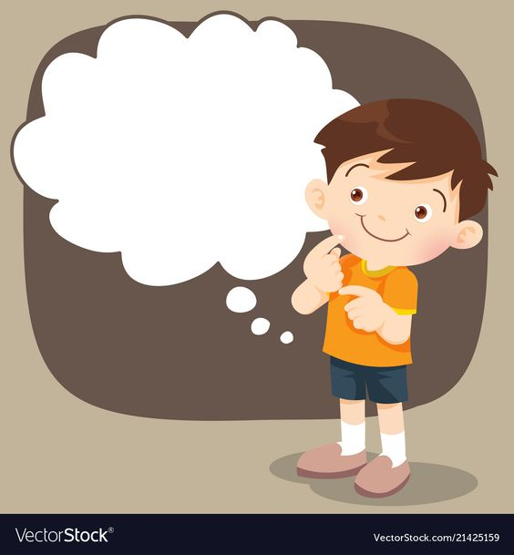

Slide 12
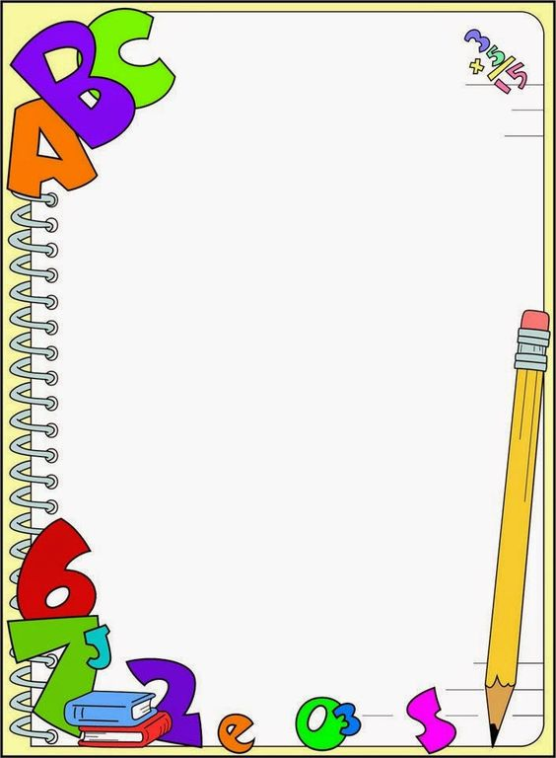
Workbook page 9
6
3
2
7
4
5

Slide 13
2/page 9
Circle the correct word.

Slide 17
Stick in the box, please!
Very satisfied
Satisfied
Not satisfied

Slide 18
PEOPLE’S COMMITTEE OF DISTRICT 3 NGUYỄN THI PRIMARY SCHOOL
Thanks for your watching.
Teacher:Võ Thị Mỹ Phượng
Nguyễn Thi primary school’s website
https://thnguyenthiq3.hcm.edu.vn

